Slide 1
Virtual Clay Modeling
Abrie Greeff
Project 4
April 14, 2006

Slide 2
Introduction
3D modeling
Free-form modeling
Using cellular automata

Slide 3
Virtual Clay Modeling
Initial mass distribution
Transitions of every cell
Clay deformation

Slide 4
Margolus Neighbourhood
Two different steps
Block of four cells
Boundaries
Repartition rule applied

Slide 5
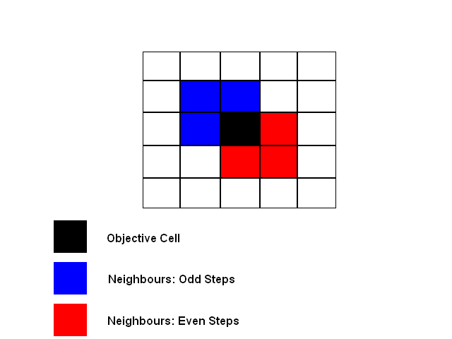
Comparison of Odd and Even Steps

Slide 6
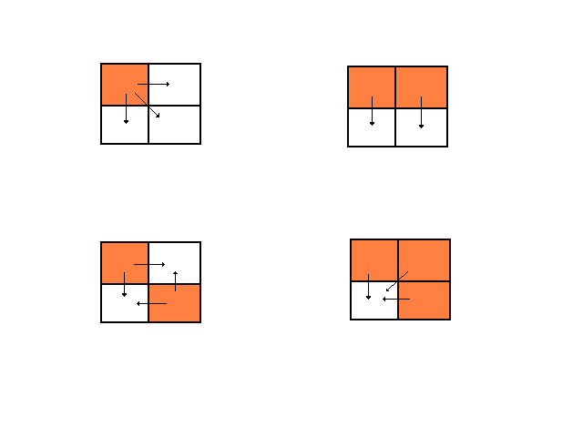
Repartition Rule

Slide 7
Implementation
Data storage
Time complexity
Initial configuration
Deformation phase

Slide 8
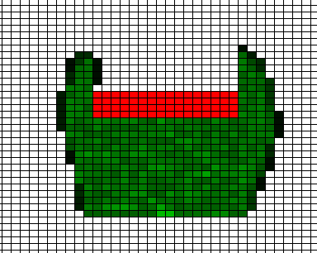
Clay deformation

Slide 9
Testing
Two types of test were considered
Big block of clay
Small block of clay

Slide 10
Conclusion
Improvements
Real time computation

